Slide 1

WEFTEC 2026
Booth Application Process
A Step-by-Step Guide

Slide 2

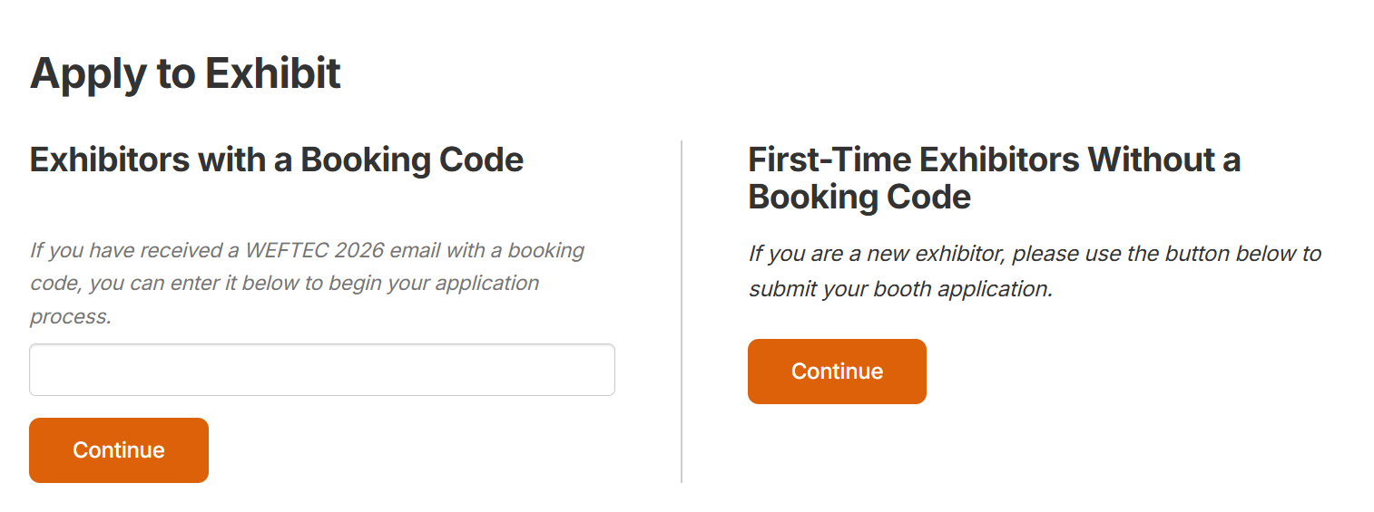
Starting Your Application:
Select if:
You were emailed a booking code on Monday Dec. 1 or later.
Your company exhibited at WEFTEC 2025 but did not participate in Onsite Sales.
Your company last exhibited at WEFTEC 2024.
Select if:
You did not receive an emailed booking code.
Your company has never exhibited at WEFTEC.
Click here to access the application.

Slide 3
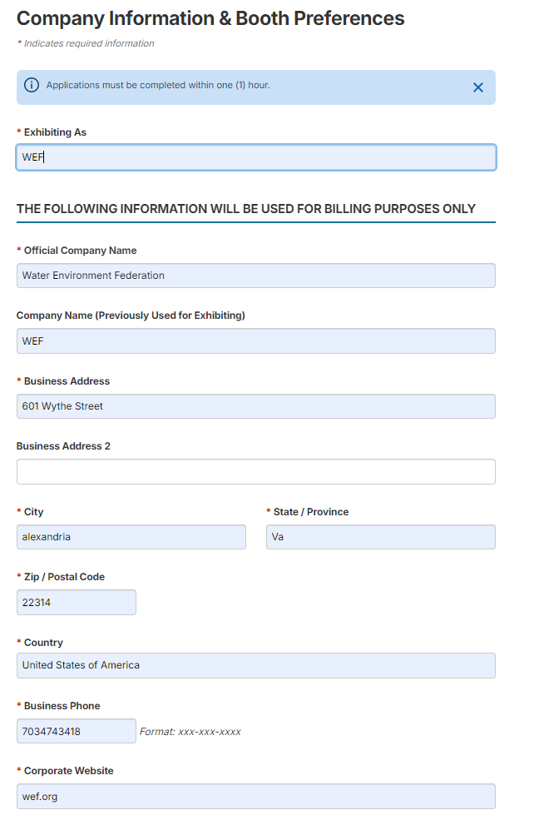
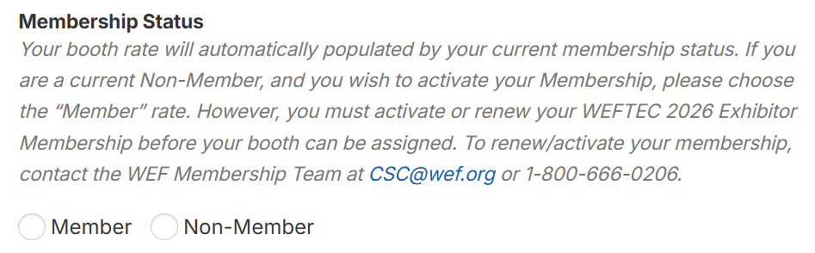

Step 1 – Company Information & Booth Preferences
Select your Exhibitor Membership Status:
Click here to learn about the benefits of exhibitor membership.
If you are unsure of your membership status or would like to activate/renew your membership, contact CSC@wef.org or 1-800-666-0206.
Complete your company information.
This information is used for billing purposes only. You will have the opportunity to enter your public facing directory listing information after your booth is assigned.
The application must be completed within one (1) hour, or the system will time out and your information will not be saved.​
Required fields are marked with a red * or are highlighted in RED

Slide 4
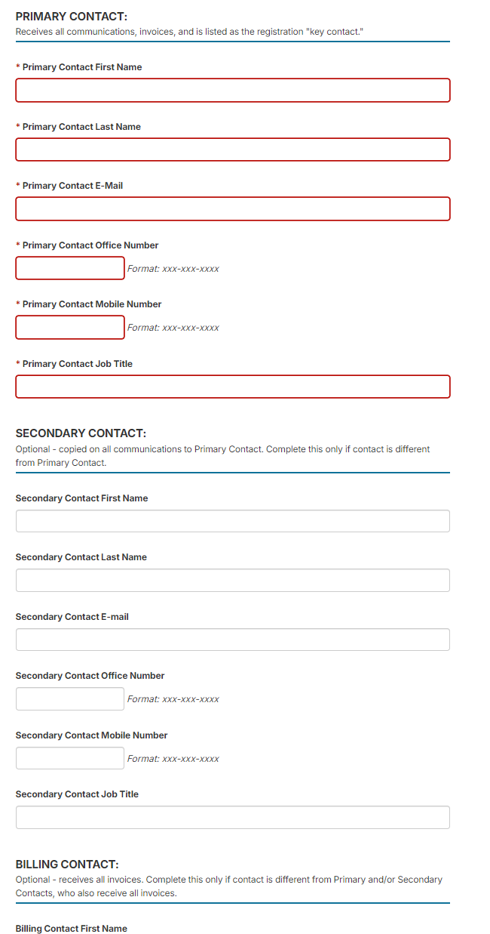
Step 1 – Company Information & Booth Preferences (continued)
Enter contact information:
Primary Contact is required, Secondary and Billing Contacts are optional, but encouraged if these contacts are different than the Primary
Required fields are marked with a red * or are highlighted in RED

Slide 5
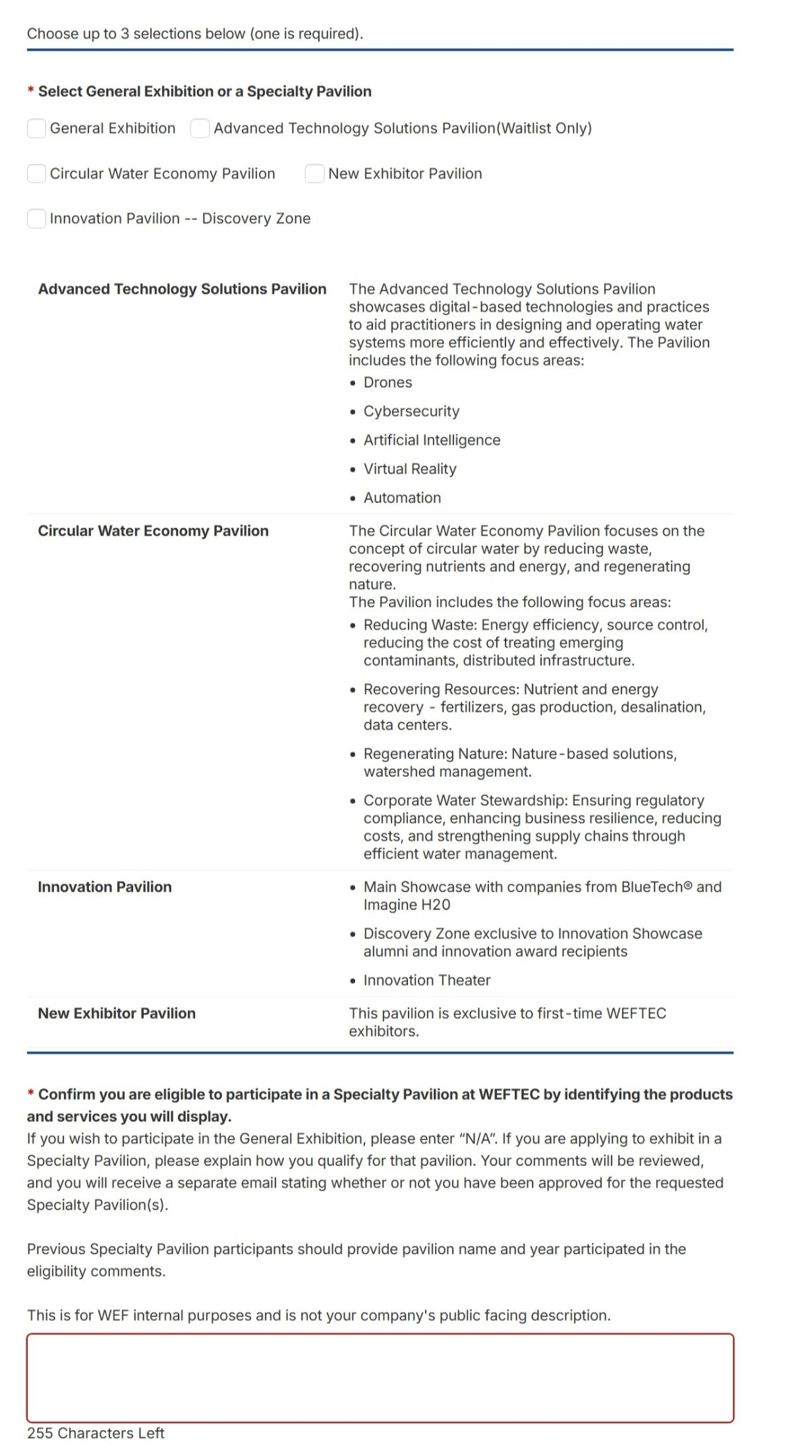
Step 1 – Booth Location Preferences (continued)
Where would you like your booth to be located?
Click the box for a booth located in the General Exhibition or in a Specialty Pavilion.
One option is required. You can select up to three options.
Exhibitors must qualify to participate in Specialty Pavilions. Follow instructions to pre-qualify for specialty pavilions. If description is not provided, booth assignment can be delayed.
For consideration to be placed in a Specialty Pavilion, read the pavilion descriptions on the application page and provide a description of your offerings.

Slide 6
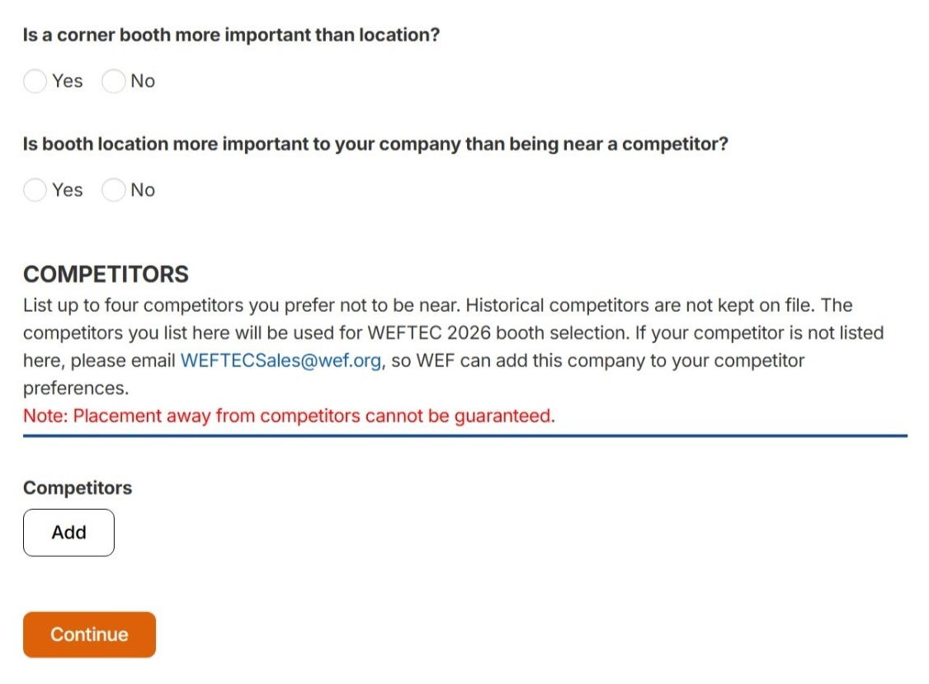
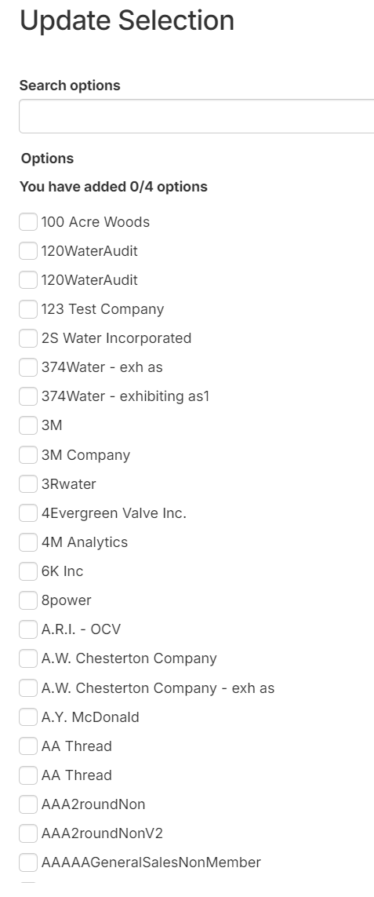
Step 1 – Booth Preferences (continued)
Complete Booth Preferences
Choose if a corner booth is more important than the location of the booth.
Choose if the booth location is more important than being near a competitor that you selected.
Using the drop-down menu, you can select up to four competitors that you wish not to be near.
The competitors you list on this application are only used for WEFTEC 2026 booth space selection. If you do not see a competitor on this list that you would like to be included, email WEFTECSales@wef.org, and WEF staff will add it to your record once your application has been submitted.
You can either scroll through the list of companies or type a name in the "Search Options" box

Slide 7
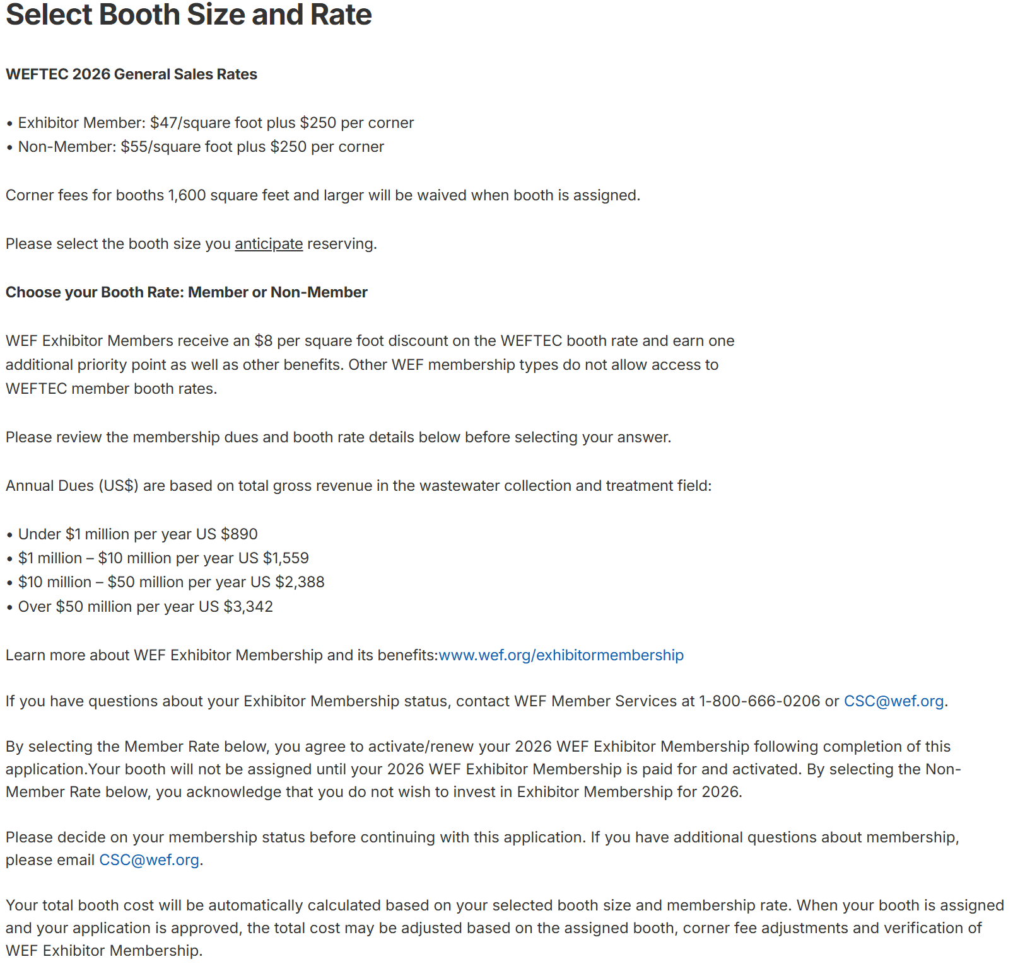
Step 2 – ​Select a Booth Size and Rate
Member Rate: $47/sq. ft.
Non-Member Rate: $55/sq. ft.
Plus, an additional $250 fee per corner*
Corner fees are waived for booths 1600 sq. ft. and larger
Membership status will be verified before assignment is made.
For more information about Exhibitor Membership, visit https://www.wef.org/exhibitormembership
If selecting the member rate, be sure you have an WEF Exhibitor Membership. Only this membership category qualifies your company for the member rate. Individual, Professional and Corporate memberships do not receive the member rate for WEFTEC booth space.

Slide 8
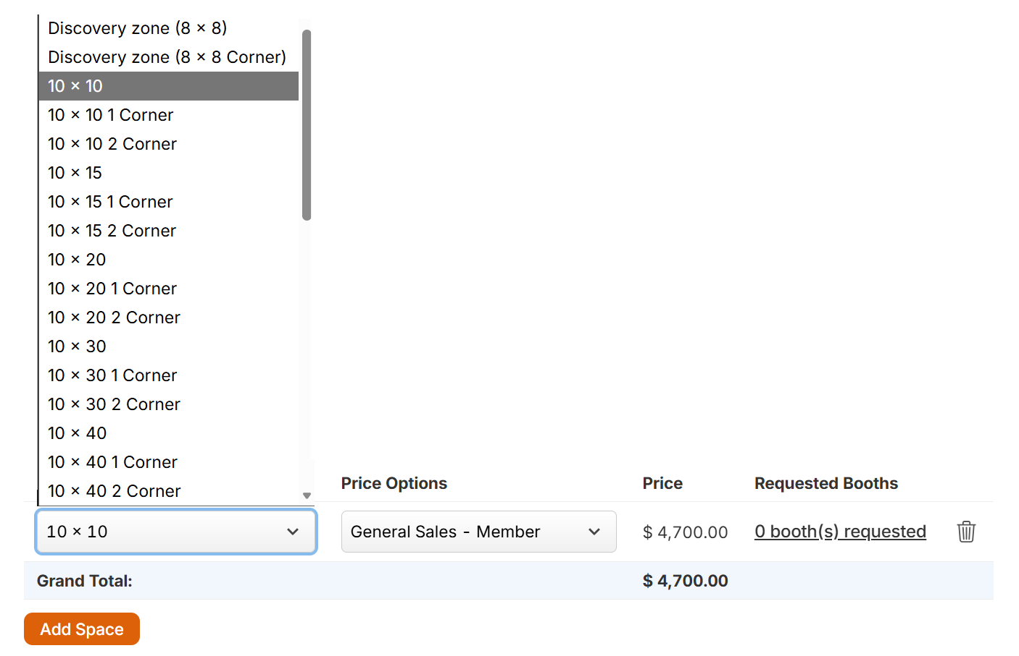
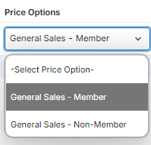

Step 2 - Select Booth Size and Rate (Continued)
Select your booth size and number of corners using the drop-down menu.
Then, select your membership status (this will be verified before assignment).
The rate will automatically populate based on your selections.
Corner fees are for open corners that do not butt up to another booth.
The application must be completed within one (1) hour, or the system will time out, and your information will not be saved.​

Slide 9
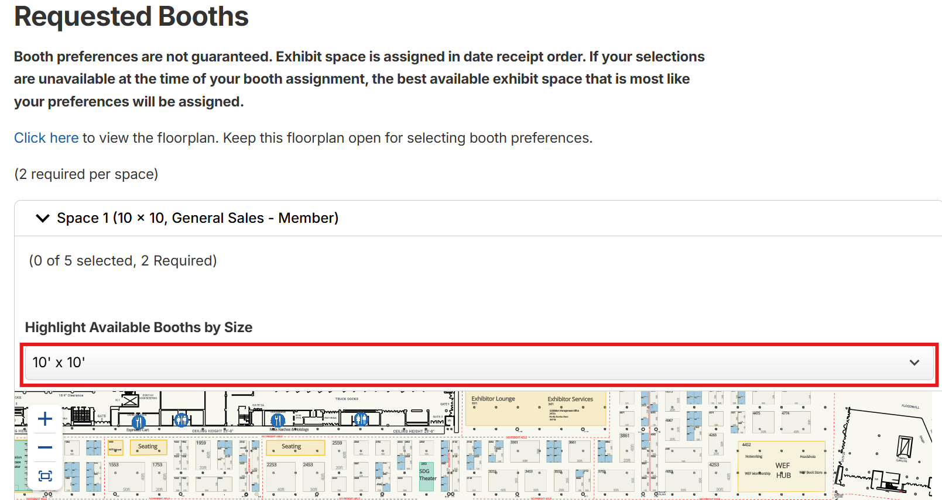
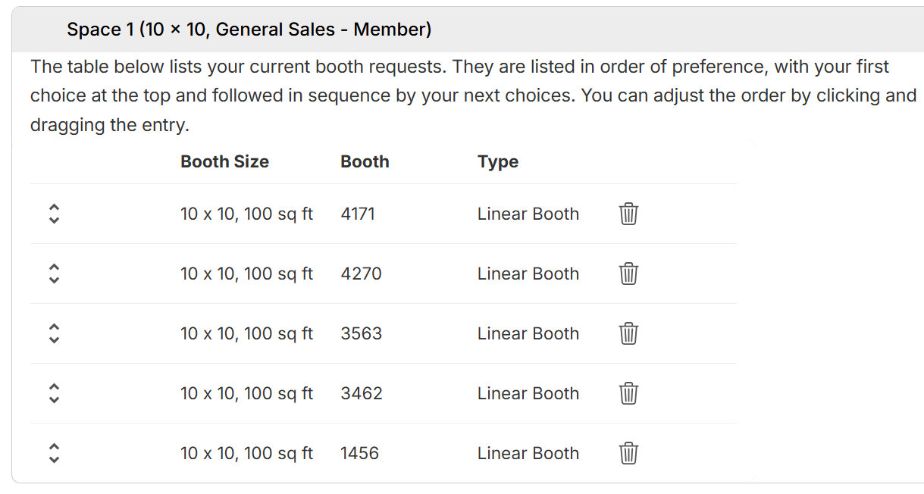
Step 2 - Select Booth Size and Rate
(Continued)​
After selecting your booth size and rate, choose your booth size from the drop-down menu to highlight the available booth options on the floorplan. Click the preferred booths in order of preference (select 5). Your selections will then be listed in order of preference. Click Continue when complete.
You can change the order of your booth choices by dragging the arrows on the left of the list up or down which will reorder them.

Slide 10
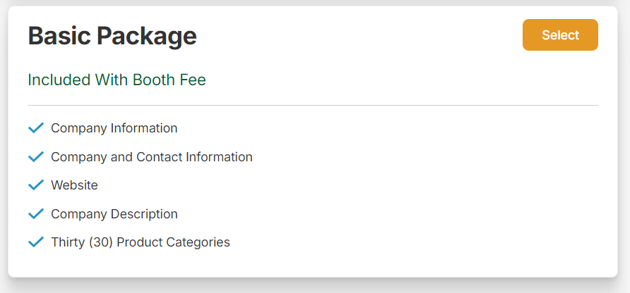
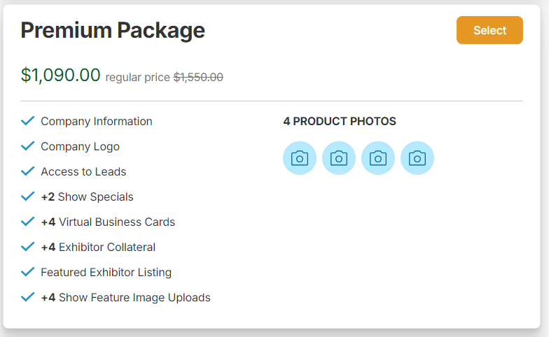
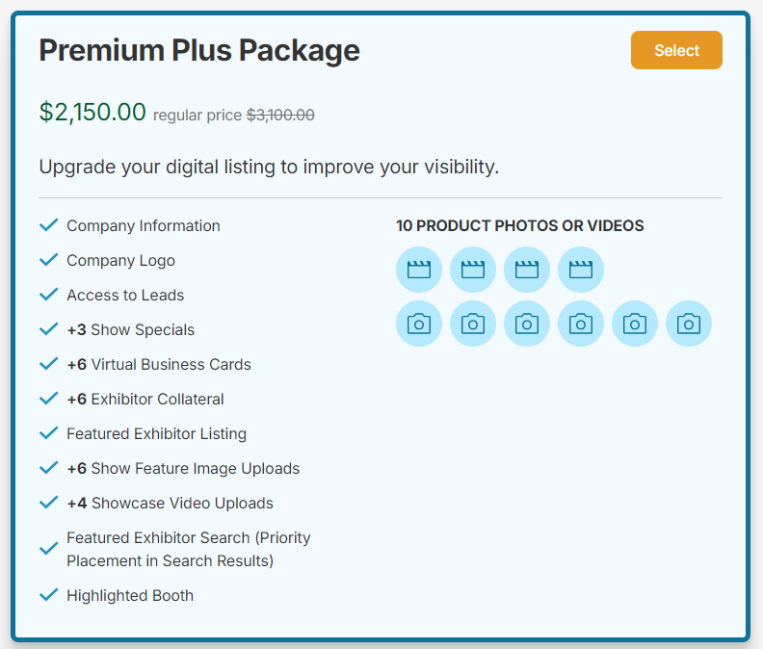
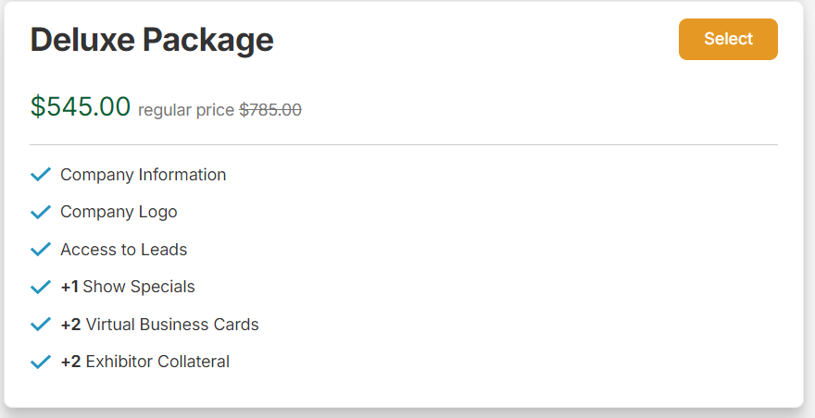
Step 3 – Packages
WEFTEC Digital Exhibitor Listings: Maximize your online exhibitor directory listing and receive up to a 31% discount when you invest during this booth application process. You must select one package to move forward in the application.
The Basic Package is included with your booth. You can upgrade to Deluxe, Premium, or Premium Plus to gain additional exposure for your presence at WEFTEC.

Slide 11
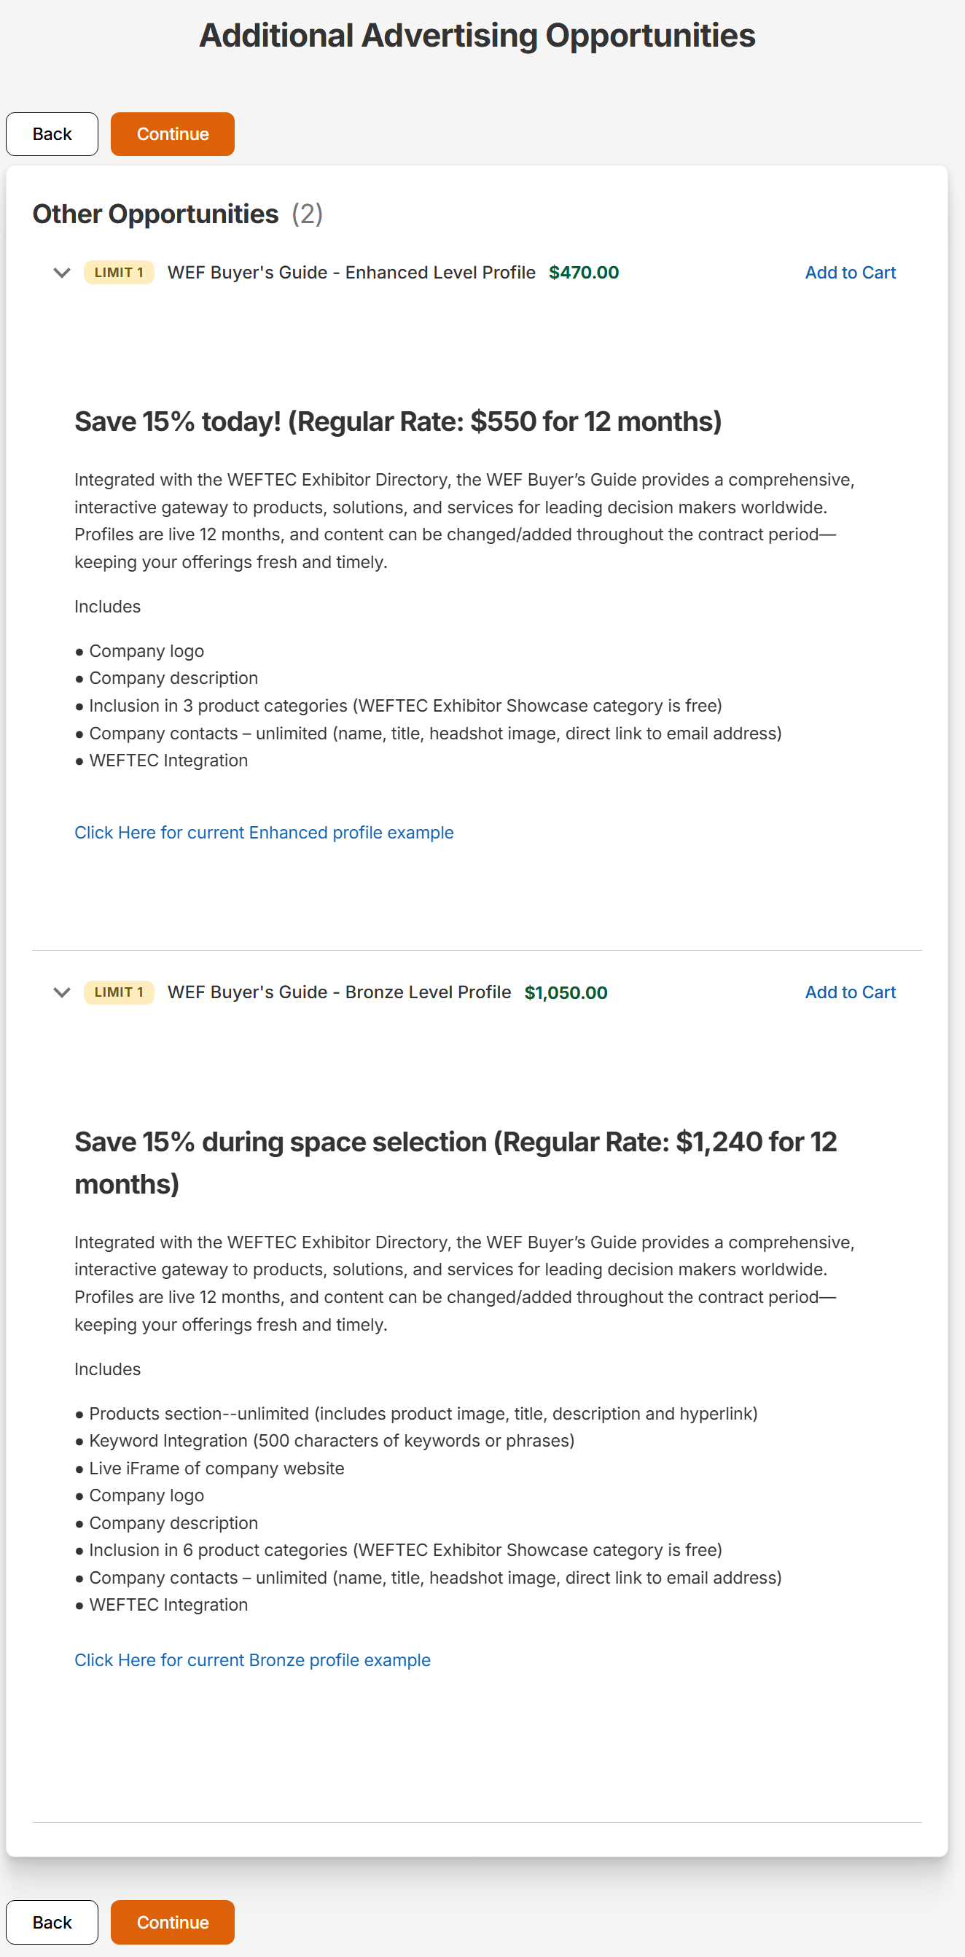
Step 4 – Additional Advertising Items
The WEF Buyer’s Guide is heavily integrated with the WEFTEC Exhibitor Directory and will enhance your exposure for WEFTEC and throughout the year.
Receive a 15% discount on these opportunities if you select a package while completing your booth application.
Click to see examples of current listings.
Be sure to click ‘Add to Cart’ if you would like to add the item.
Click “Continue”, at the bottom or top of the page when complete.

Slide 12
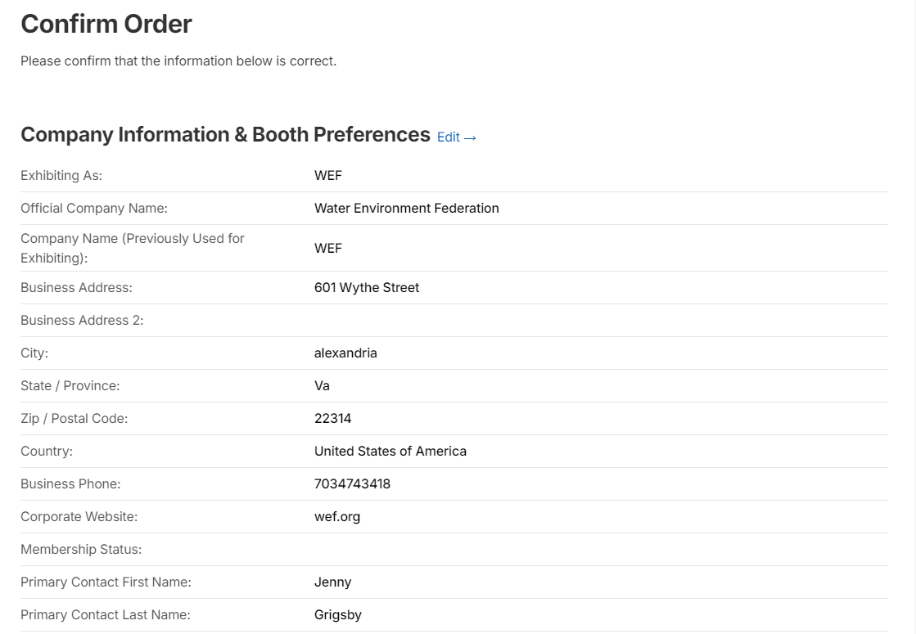
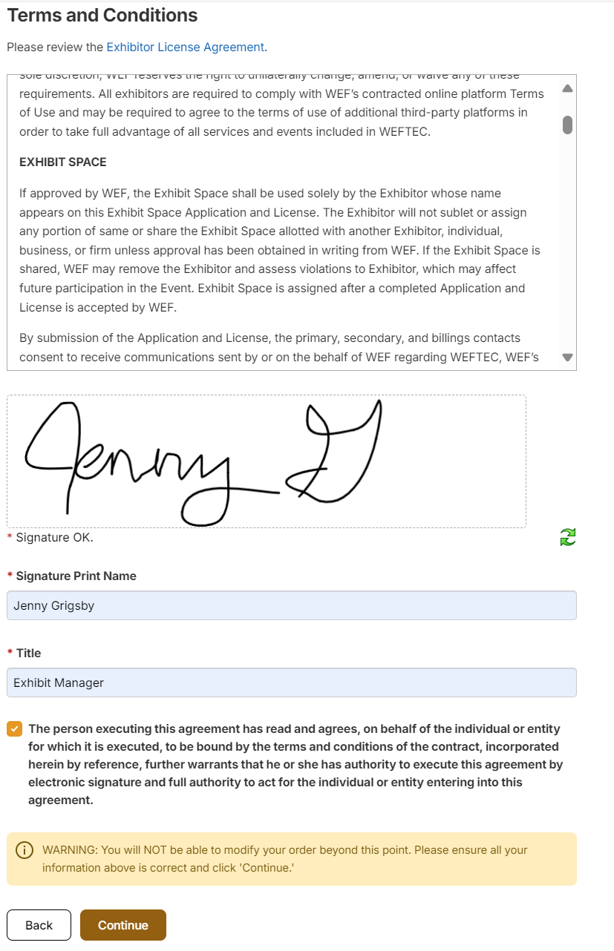
Step 5 – Confirm Order
Review your exhibit application.
If any changes need to be made, click ‘Edit’ to go back.
At the bottom of this page, indicate your agreement to the WEFTEC Exhibitor License Agreement by providing a signature, name, and job title of the person completing the application.
Once the ‘Continue’ button is clicked at the bottom of the page, you WILL NOT be able to go back to change your application.

Slide 13
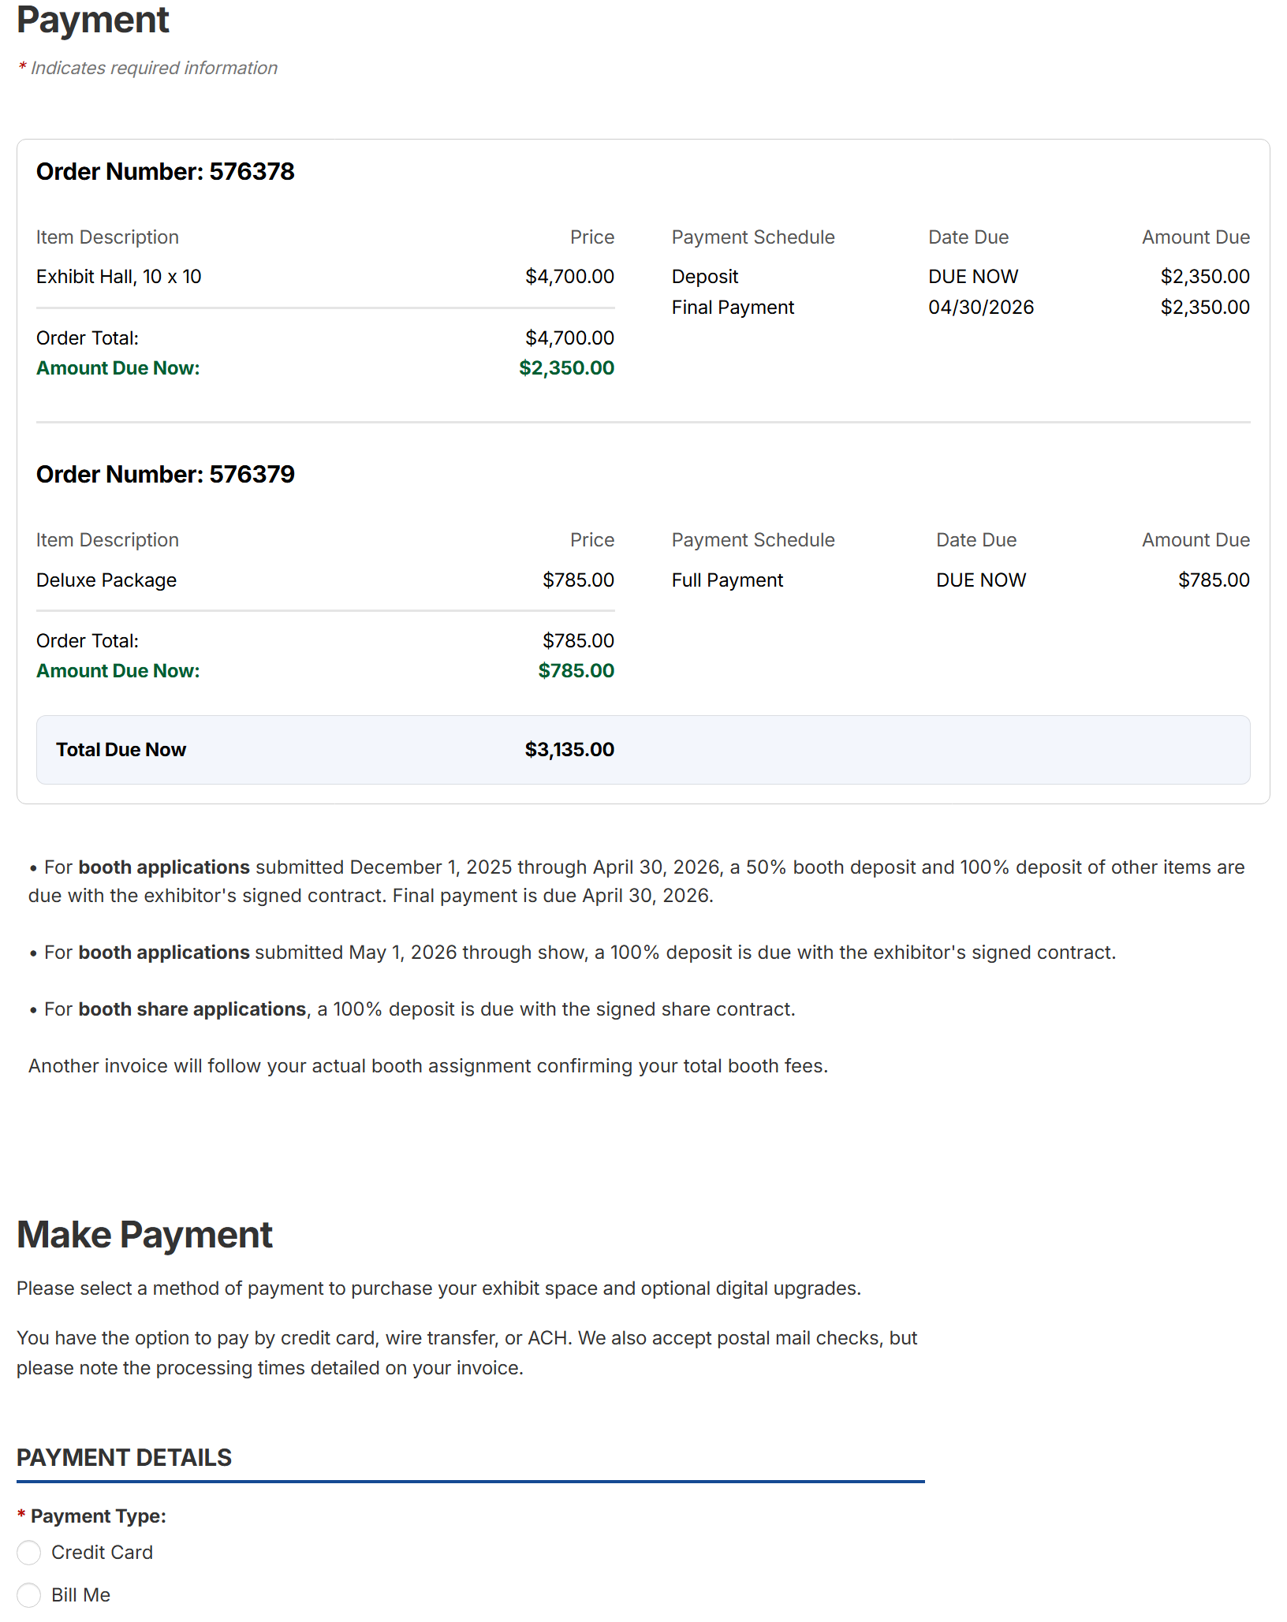
Step 6 – Payment
A 50% deposit for your exhibit space is due with the booth application. The remaining balance is due by April 30, 2026.
Any applications submitted on May 1 or later require a 100% booth deposit to be reviewed/assigned.
If an exhibit credit was transferred to WEFTEC 2026, you will see “Applied Credits” notated under your total.
Under ‘Payment Details’, select ‘Credit Card’ or ‘Bill Me’. By selecting ‘Bill Me’, you choose to make a payment by check, wire transfer, ACH, etc. An invoice will automatically be sent when this option is selected.
Note: Booth assignments will not be made without the required 50% booth deposit.
Using a credit card to pay the 50% deposit now will keep your place in date receipt order for a better booth assignment.

Slide 14
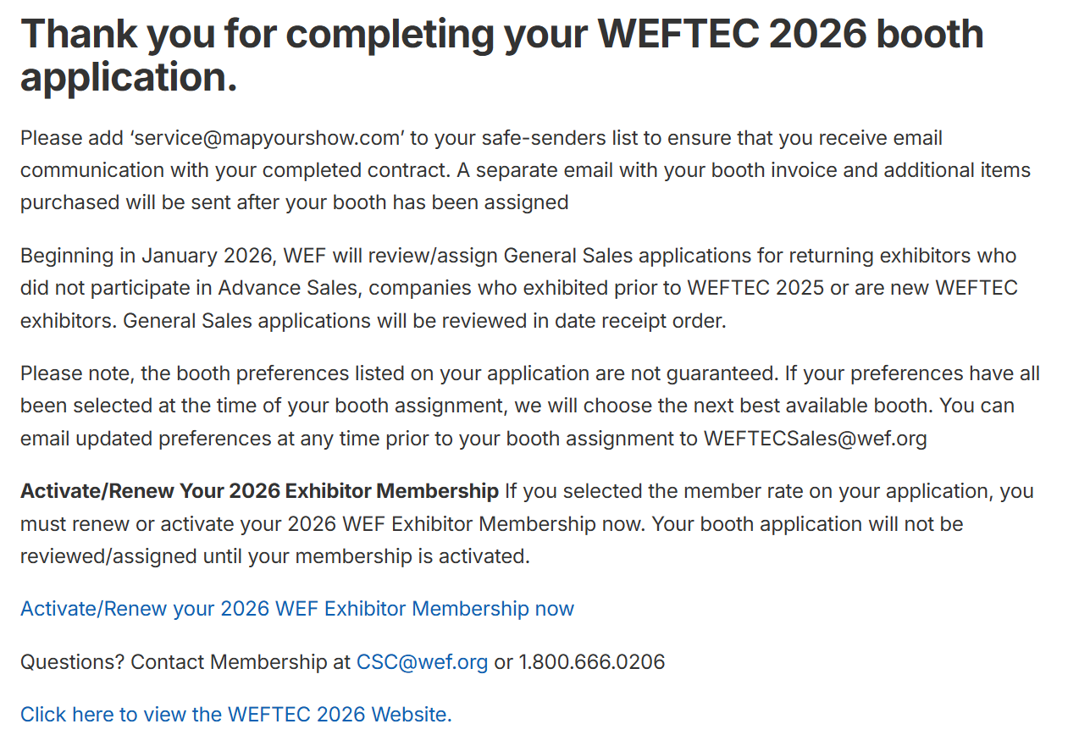
Step 7 – Complete Order
After the ‘Process Payment’ or ‘Process Invoice’ button is clicked, the application is complete.
You will be automatically sent an email with a copy of your completed contract and booth invoice.
Be sure to add WEFTECSales@wef.org and service@mapyourshow.com to your safe senders list.

Slide 15
Questions?
Contact Us:
WEFTEC Exhibition Sales +1.703.684.2437 | WEFTECSales@wef.org
Expo Information
+1.703.684.2443 | expoinfo@wef.org
Advertising & Sponsorship Sales
Amy LaTessa, Director, Sales & Customer Success
+1.703.684.2406 | alatessa@wef.org
WEF Member Services
+1.800.666.0206 | csc@wef.org
www.wef.org/exhibitormembership

